Slide 1
Warming up Storage-Level Caches with Bonfire
EECE 5643: Shiyue Hou Paper
Presentation

Slide 2
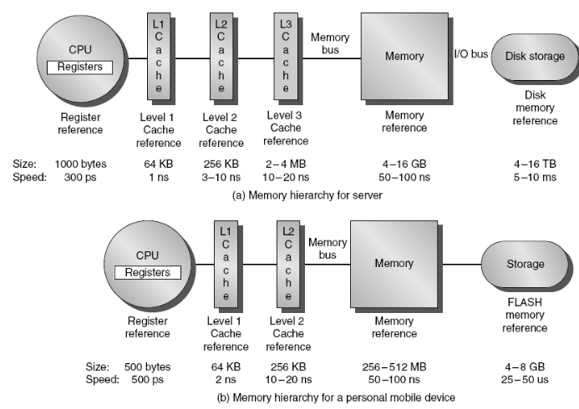
Introduction
CPU Cache

Slide 3
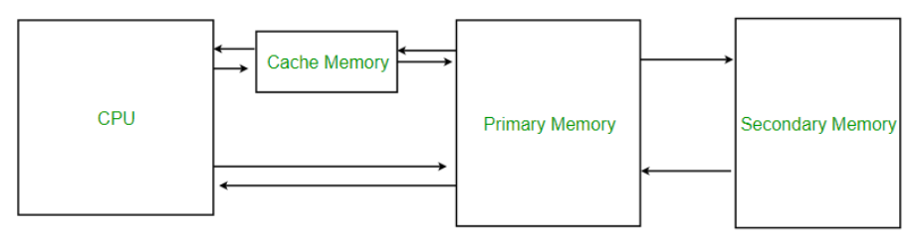
2. Memory Cache

Slide 4
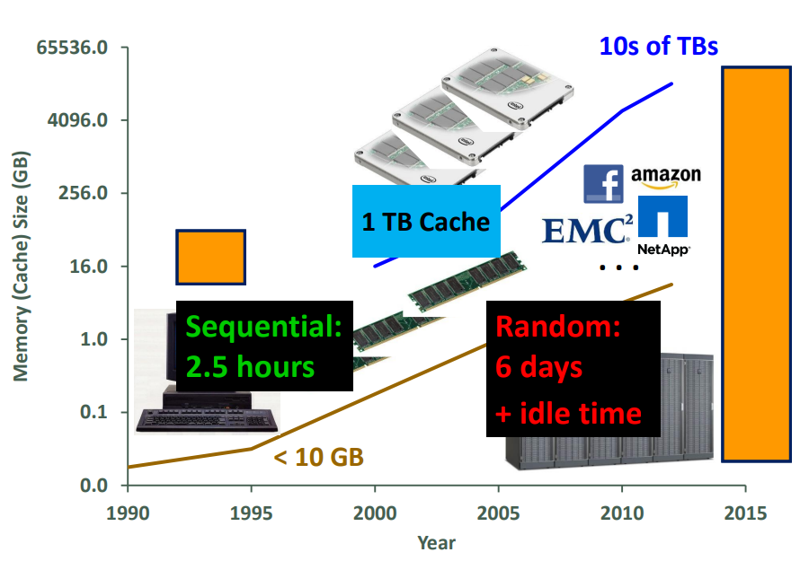
Motivation:
On-demand cache warmup still work?
Notes:
Cache is maintained main memory and used less than 10GB. Fill data into cache is fast.
Within 10 decade, the flash-based cache has prevalent. And nowadays, high end flash SSD can be tens of TB.
Data increase, server to store, cache size need to bigger and bigger
The problems are: The bigger cache and fill it takes a lot of time.
Let we do a simple calculation.
Moreover, on demand cache, the idle time in the workload will make this time even longer

Slide 5
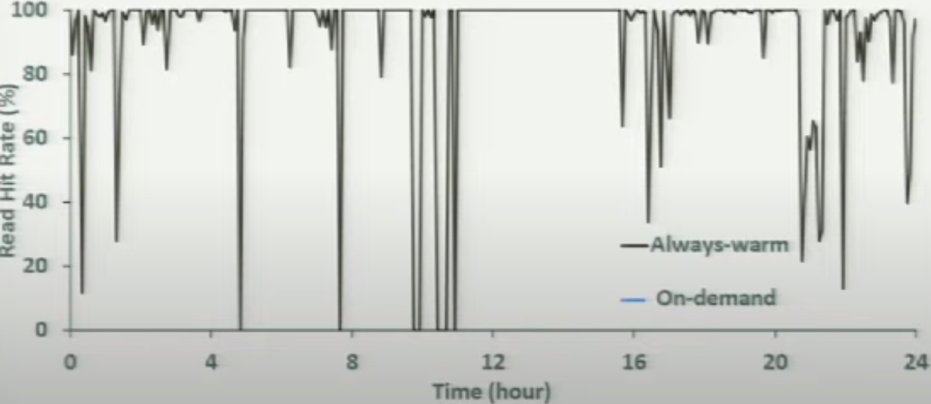
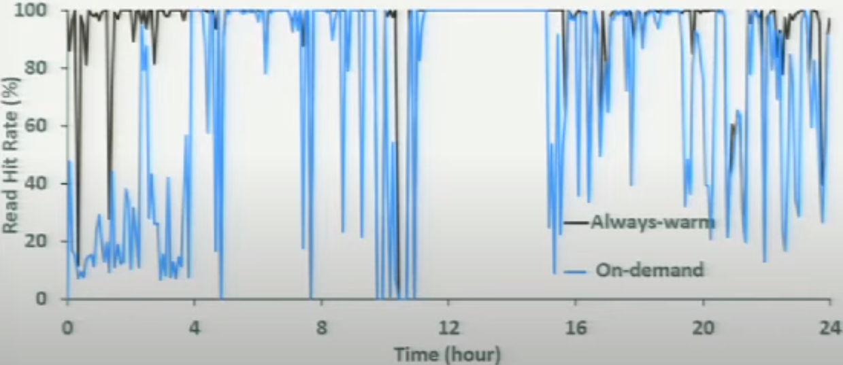
How long Does On-demand warmup Take?
Notes:
On-demand warmup takes hours to days
The first four hours the on-demand cache is doing much worse than warm cache. And even after almost one day it can still perform poorly .

Slide 6
To Make Things Worse
Cache are critical
  Key component to meet application service-level agreements (SLAs)
  Reduce storage server IO load
  Cache warmup happens often
    Storage server restart
    Storage server take-over
    Dynamic caching
Notes:
A server storage can fail and its high availability can take over. And new server won’ have any kind of cache content. And need to be warmed.

Slide 7
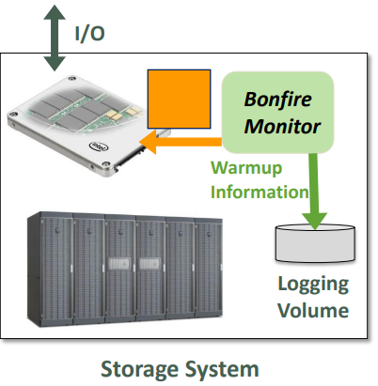
Bonfire
  Monitors and logs IOs.
  Load warmup data in bulk.
  Challenges
    How to monitor and log.
    How should we do monitor log
    When the new cache start, how
    to load metadata.
Notes:
Bonfire monitors storage io and log useful information to local logging valume.
When the new cache starts. It load warm up data in bulk.

Slide 8
Summary of Contributions
  Trace Analysis for storage-level cache warmup
  Cache warmup algorithm design and simulation
  Implementation and evaluation of Bonfire
    Up to 100% warmup time improvement over on demand.
    Up to 200% more server IO load reduction.
    Up to 5 times lower read latency.
    Low overhead.

Slide 9
Trace Analysis
  Trace Selection: 36 one week block –level traces from MSR Cambridge data center
  Trace Study Summary
    Use recently access blocks for warm-up.
    User same period from previous day to warm up the current period.
 | Time | Space
Relative | Reaccesses have two main temporal patterns: within 1 hour, around 1 day | Hourly reaccesses are close in spatial distance. Daily reaccesses exhibit spatial clustering.
Absolute | Daily reaccesses correlate with wall clock time | No hot spot of reaccesses in LBA space
Notes:
The trace analysis within two dimensions: Time and space
We study both the relative relationship between reaccess (traces are read after read and read after write):
Within the traces study. It better for design algorithm and data structure. Ex, according to traces study. It can be knowing which data is likely to be reaccess. And what data to log and to useful warmup.
Question 1: What is the temporal distance between a reaccess and its previous access.
LBA: Logical block addressing

Slide 10
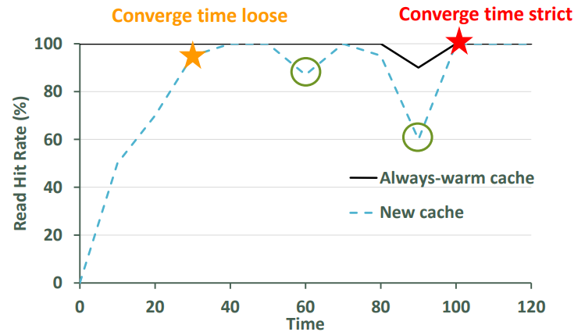
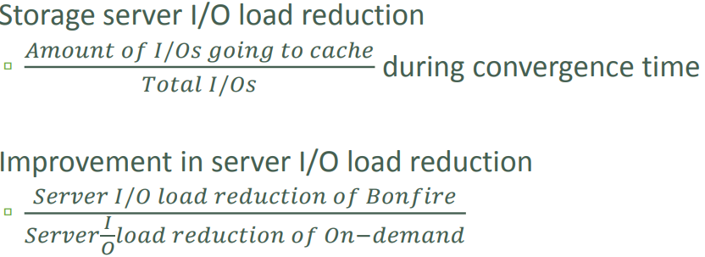
Bonfire Measurement
  Metrics: Warmup Time – hit rate convergence time
  Metrics: Server IO Load Reduction
Notes:
Defind a set of metrics which use to evaluate warm up benefit.
1. First defind warmup time: hit rate convergence time
2. We further allow minor fractuations, if we do so. We have loose definition of convergence time at time 30s.
3. We mean that the amount of IO going to the cache out of the total amount of IO during convergence time.
4, This value should be more than 100 percent.

Slide 11
Bonfire Design
  Design Principles
    Low overhead monitoring and logging.
    Bulk loading useful warmup date.
    Techniques
      Monitors IO below the server buffer cache
      Performance snapshot
Notes:
When the new cache start, it load warmup data in bulk.
Monitors IO below the server buffer cache, because this way we won’t be on the IO critical path.
Performance snapshot: to store actual data for faster warm up.

Slide 12
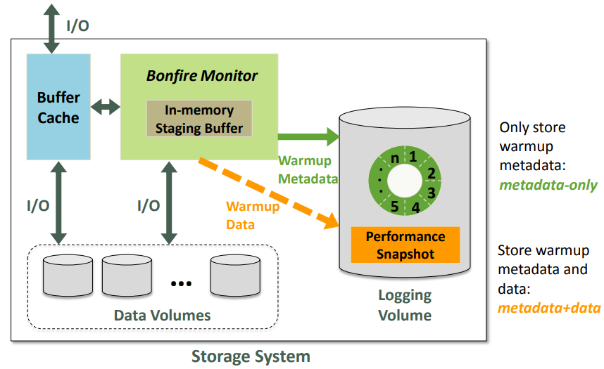
Bonfire Architecture: Monitoring
Notes:
It has two phases; the first phase is the monitoring phase. This is storage system with a bunch of slow data storage and server buffer cache. Bonfire monitors below the buffer cache. It keep an in-memory stage buffer for its own metadata and the actual data. When the metadata buffer is full. It writes the warm-up metadata to a circular log on the logging volume. The logging volume can be bother SSD or hard disks. The warm metadata doesn’t mean the file system metadata. It is the metadata used by bonfire and can contain things, such as Logical block addressing (LBA). And we call this scheme metadata only. And another way bonfire can write the actual data to a fixed location called performance snapshot.

Slide 13
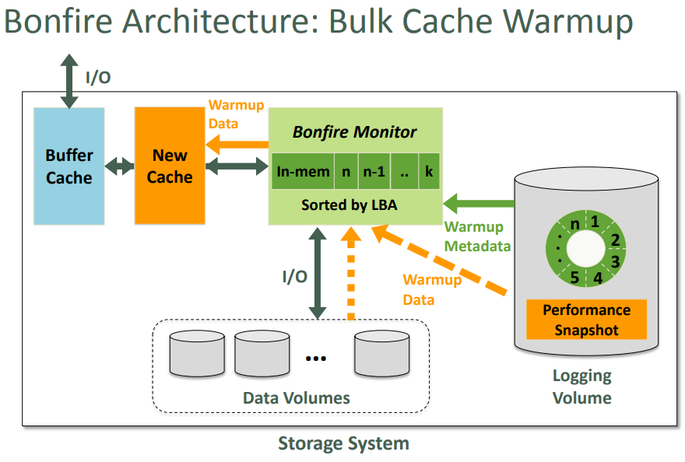
Bonfire Architecture: Bulk Cache Warmup
Notes:
The second phase is the warm up phase. Imagine a workload suddenly changes and your IO to this server increase. So one way to accommodate this situation is to add a new cache or extend the original offer cache size. So when the new cache is started. Bonefire first load the warm up metadata from the circular log in reverse time order. And if we use the metadata+data on a plus data scheme. The bonefire reads the warm up data from the performance snapshot sequentially. And if we use the metadata only scheme. Then bonefire will sort the metadata by Logical block addressing (LBA) and read the data from the original data volumes. And finally it will load the warm up data into the new cache invoke.

Slide 14
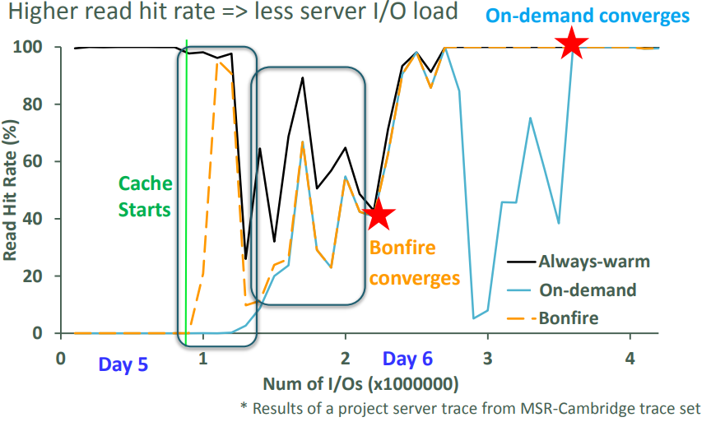
Evaluation Results
  Benefit Results – Read Hit Rate of MSR Trace
    Higher read hit rate => less server IO load
Notes:
We compare bonefire to the always warm cache and on demand warm up. We implemented both the metadata only and the metadata+data scheme.
First, show read hit rate. Higher read hit rate means more data go into the cache. Higher is better. Read hit rate over a number of IO in millions. And new cache started at 0.9 million Ios. Black line is always warm cache. Blue line is on demand cache. Oregon line is bonefire. We can see that, when the cache start. The bonefire read hit rate increase and match the always warm cache. And after that, it drops below the always warm cache. That because bonefire only use current data content. After that, bonefire converges around 2.2 millions Ios. In contrast the on demand warm up converges until almost end of trace.

Slide 15
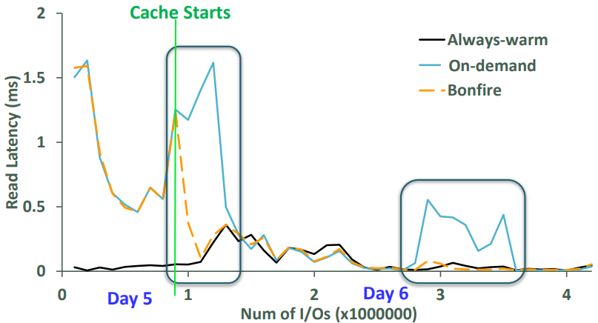
Evaluation Results
  Benefit Results – Read Latency of MSR Trace
    Lower read latency => better application perceived performance
Notes:
Here we show the read latency in millisecond over a number of Ios. Black line is …, Blue line is …, Orange line is …, We can see that after the cache starts, bonefire have a latecy increase for a while and back to stable so fast. And for on demand, it have a latency increase around 3 million Ios.

Slide 16
Summary of Results
Faster cache warmup
  59% to 100% improvement over on-demand
  Less storage server I/O load
    38% to 200% more reduction than on-demand
    Better application-perceived latency
      Avg read latency 1/5 to 2/3 of on-demand •
Notes:
To summarize the evaluation result: The bonefire reduce cache warm-up time by 59 to 100% over the on demand cache warm up. It also has 38-200% more server IO load reduction than the on demand cache warm up.
And its average rate latency is one-fifth to two thirds of the on demand cache.

Slide 17
Pros & Cons
Pros | Cons
Great summary of current research & industry | Need to explore bigger traces on Bonefire to analyze latency, hit ratio, IOPS, bandwidth etc.
Propose a new cache architecture to optimize latency, hit ratio, throughput. | Need to extend write intensive data to analyze.
Implement propose architecture at simulation and real device.
Experiment data samples is Representative

Slide 18


Slide 19


Slide 20
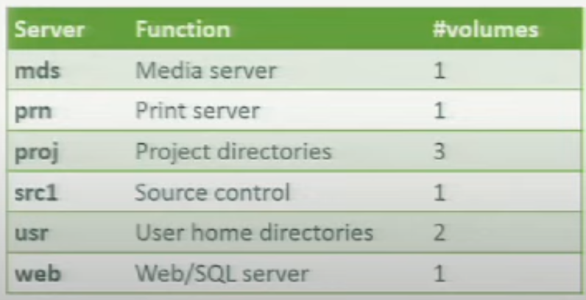
Backup:
Server Run traces

